Slide 1


QUEER THEORY

Slide 2
Queer Theory
Queer Theory rejects conventional or mainstream behaviour, including sexual identity, but also a range of identities including race, disability and gender.
It rejects the essentialist nature of theories of identity based on binary oppositions like male/female, gay/straight and argues there is another space outside which is ‘queer’.

Slide 3
Queer Theory Continues-----
Queer texts either deal with queer themes and have queer characters or are read as queer
Characters are often outsiders, on the edge of society
There has been some improvement in the representation of gay men and lesbians in the media, but queer theory rejects simple positive representations which it argues are based on queer characters and values fitting it and being acceptable to a heterosexual, mainstream audience.
Queer genres of often subvert traditional genre rules

Slide 4
Queer Theory Continues---
A field of critical theory that emerged in the early 1990s.
Explores and challenges the way in which heterosexuality is constructed as normal...
And the way in which the media has limited the representations of gay men and women.
Challenges the traditionally held assumptions that there is an oppositional divide between being gay and heterosexual
Suggests sexual identity is more fluid.

Slide 5
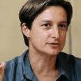
Theory: Judith Butler (1999)
Male and female behaviour roles are not the result of biology but are constructed and reinforced by society through media and culture.
She argues that there are a number of exaggerated representations of masculinity and femininity which cause “gender trouble.”

Slide 6
A summary of Butler’s key points on gender representation and queer theory
Nothing within your identity is fixed.
Your identity is little more than a pile of (social and cutural) things which you have previously expressed, or which have been said about you.
There is not really an ‘inner self’. We come to believe we have one through the repetition of discourses about it
Gender, like other aspects of identity, is a performance (though not necessarily a consciously chosen one). Again, this is reinforced through repetition.
People can therefore change.
The binary divide between masculinity and femininity is a social construct built on the binary divide between men and women – which is also a social construction.
We should challenge the traditional views of masculinity, femininity and sexuality by causing gender trouble.

Slide 7
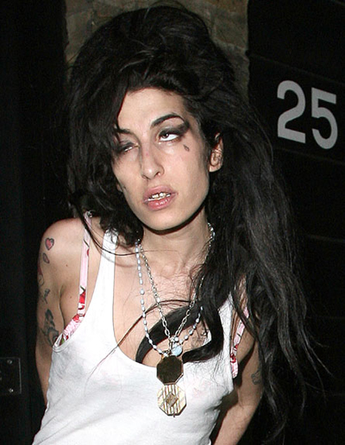
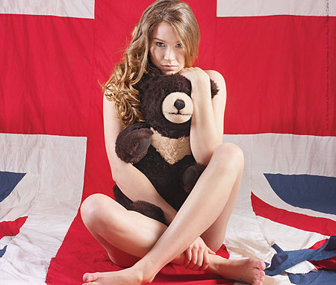
Both have built their success on challenging expected notions of femininity
Joss Stone
By being overtly sexual at a young age.
Amy Winehouse (83-11)
By living up to her ‘bad girl’ image.
Excessive consumption of drugs and alcohol.
She mixes an excess of traditional 1950s/60s femininity by wearing retro dresses that emphasise the female shape and long hair...
with a range of tattoos that would once have been considered masculine.

Slide 8
The History...
1950s – police actively enforced laws that prohibited sexual activities between men.
Sexually ‘abnormal’ and ‘deviant’.
1967 – homosexuality is decriminalised in UK (2009 for India)
In parts of Africa and Asia today it is still punishable by death
1977 – World Health Organisation refers to homosexuality as a mental illness (removed in 1990)
Civil partnerships legal in UK from 2004.

Slide 9

Queer theory suggests there are different ways of interpreting contemporary media texts
“homo-erotic overtones... ironically camp.”

Slide 10
Contemporary Texts
Queer theory can also be applied to texts where heterosexuality is dominant.

Slide 11
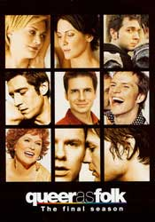
Queer as Folk (1999)
Queer theory suggests there is now a more open and fluid approach to sexuality.
There have been a number of changes in attitude.
Positive in that it represented gay culture rather than an individual character

Slide 12

Brokeback Mountain (2006)
Success of this Hollywood film an indication of more progressive attitudes to homosexuality.
For some, the film challenges two quintessential traditional images of American masculinity – the cowboy and the ‘fishing trip’.
However, it can also be suggested that the homosexual relationship portrayed here is represented as tragic – a long way from the idealised heterosexual relationships in mainstream Hollywood films.
As the film is set in the 1950s, some would also argue that this suggests issues of homophobia belong in the past.

Slide 13
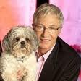
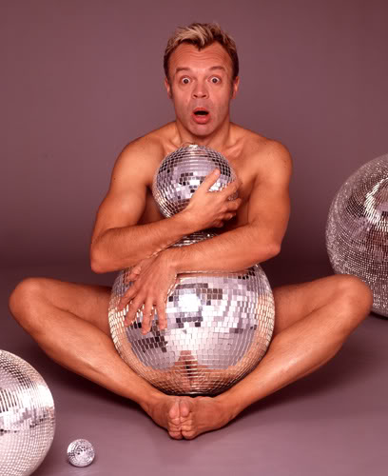
Involves an exaggerated performance of femininity.
Emphasis on style, image, irreverence and breaking taboos.
A camp style draws attention to how masculinity is constructed.
Challenges the traditional notions of masculinity.

Slide 14

Lesbianism
Never made illegal
Yet suppressed in British culture in 19th and 20th centuries.
Media representations of lesbians are far less frequent.

Slide 15
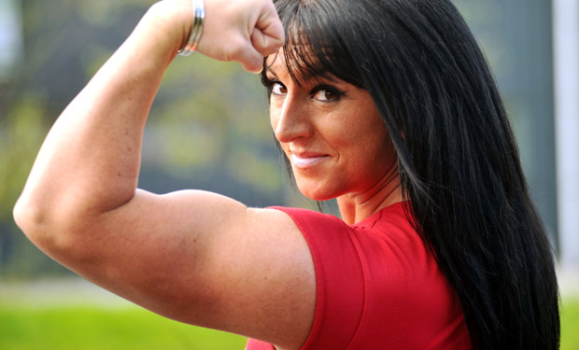
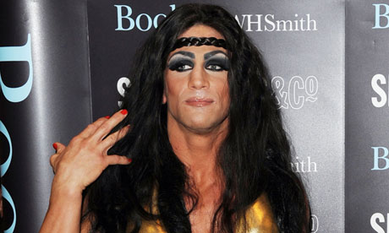
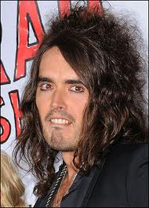
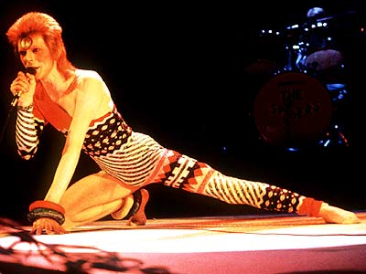
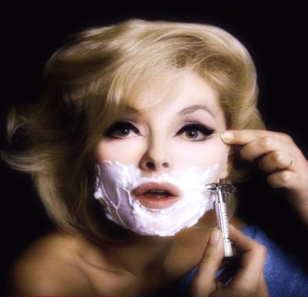
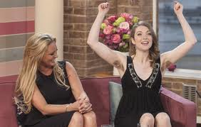
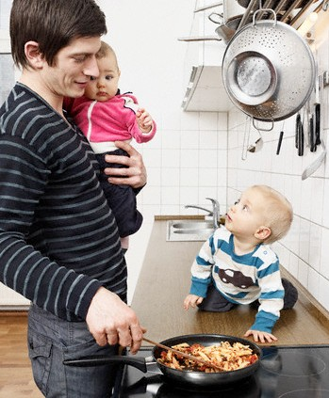

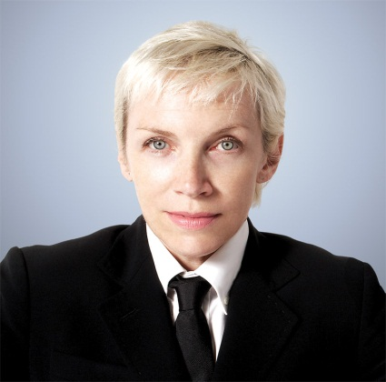
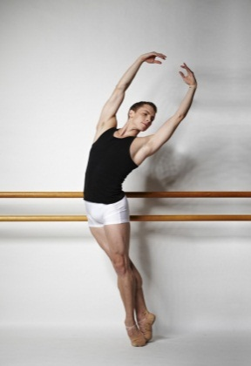
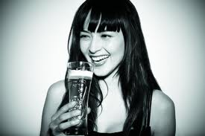
GENDERTROUBLE?
Notes:
Look at the pictures on this slide. How do they challenge assumptions on gender? Beyond biological differences what is it that makes somebody “male” or “female”? Think about how ideas about gender are reinforced by media representations. Is there a hegemonic ideal of male and female roles in society?

Slide 16
Conclusion...
‘Gender trouble’ is evident everywhere in mainstream media.
Queer theorists suggest this is evidence of a move towards increasing tolerance of sexual diversity.
Others argue that these representations simply present alternatives to the ‘norm’ of heterosexuality.
Are they just used because of their shock value, not due to any desire to promote diversity?

Slide 17
THANKS

